Slide 1
CHRONIC DISEASE RISK PREDICTION DASHBOARD
1
CAPSTONE PROJECT
Presented By:
Student Name- Gk.Gowsikaguru
College Name- Bishop Heber College (Autonomous)
Department- M.sc.Zoology
4. AICTE ID- STU6a5fb0e83425c1784656104

Slide 2
OUTLINE
Problem Statement
Proposed System/Solution
System Development Approach (Technology Used)
Algorithm & Deployment
Result
Conclusion
Future Scope
References

Slide 3
Problem Statement
Chronic diseases such as diabetes, heart disease, and hypertension are major long-term health concerns.
Early identification of people at higher risk can support timely medical attention and preventive care.
Traditional risk assessment may require manual analysis of multiple health parameters.
Patients may find it difficult to understand how factors such as age, BMI, blood pressure, glucose level, and lifestyle contribute to disease risk.
Therefore, there is a need for an easy-to-use dashboard that can analyze health-related inputs and present chronic disease risk in a simple and understandable way.

Slide 4
Proposed Solution
AI-Based Risk Prediction: Analyze user-provided health and demographic information.
Risk Assessment: Predict the likelihood/risk level of selected chronic diseases.
Interactive Dashboard: Display input parameters and prediction results in a clear visual format.
Risk Visualization: Present results using cards, charts, and risk indicators.
Preventive Guidance: Provide general lifestyle and health-management suggestions based on the predicted risk.
User-Friendly Interface: Allow users to enter health information and receive results quickly.

Slide 5
System Approach
Technologies Used:Python, StreamlitGoogle, Gemini / GenAI API (if you actually used it)IBM BobMachine Learning / AI techniquesPandasData visualization libraries
Input Features:Age, Gender, BMI, Blood pressure, Blood glucose level, Cholesterol, Physical activity, Smoking/alcoholstatus,
Family history, Other relevant health parameters
Output: Predict chronic disease risk, Risk level/category, Important contributing factors and Preventive recommendations

Slide 6
Algorithm & Deployment (1/2)
Workflow:
User Health Data
↓
Data Processing
↓
Risk Prediction Model
↓
Risk Classification
↓
Dashboard Visualization
↓
Preventive Guidance
Deployment:
Developed as an interactive Streamlit web application locally at http://localhost:8501 with the GEMINI_API_KEY
Users enter health-related parameters through the dashboard.
The system processes the inputs and displays the predicted risk.

Slide 7
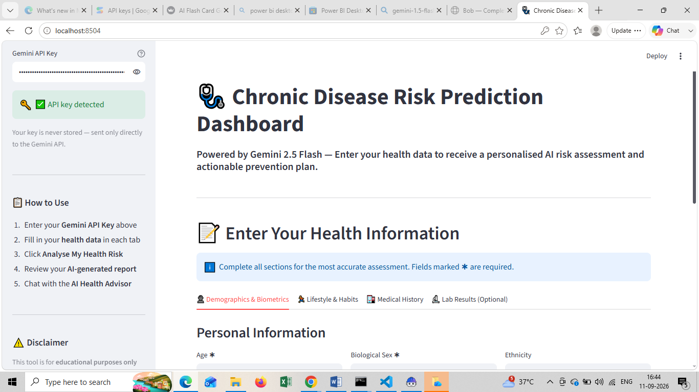
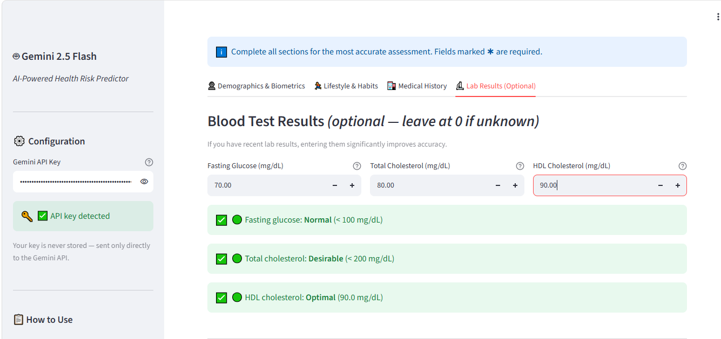
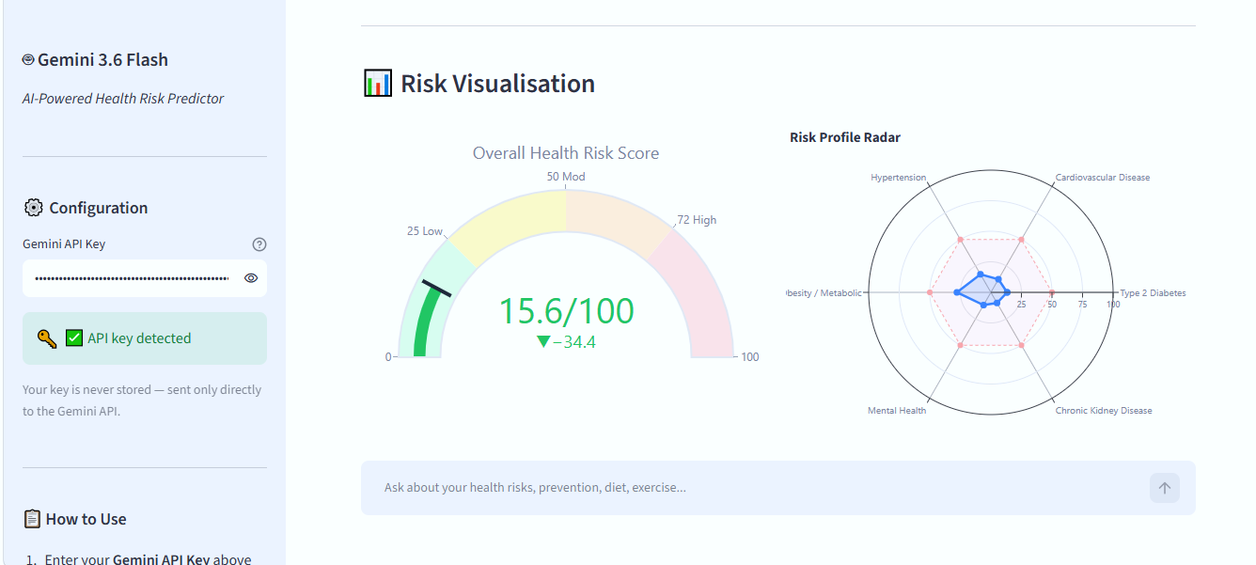
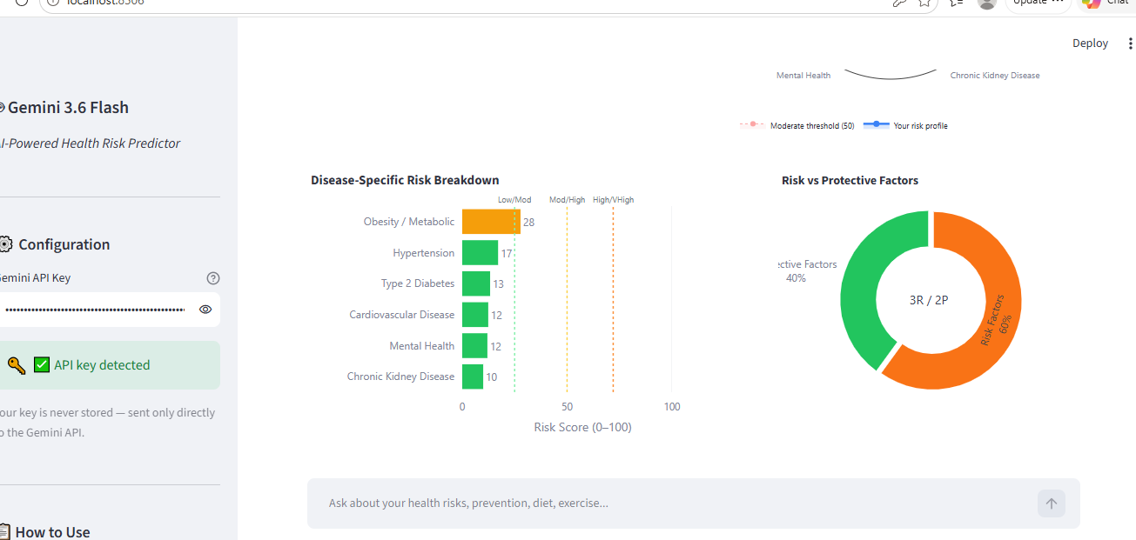
RESULT(1/2)

Slide 8
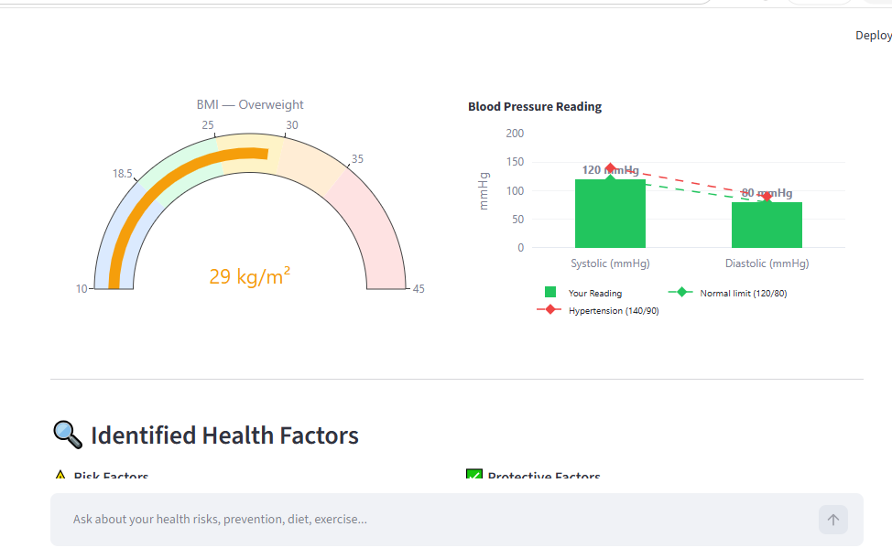
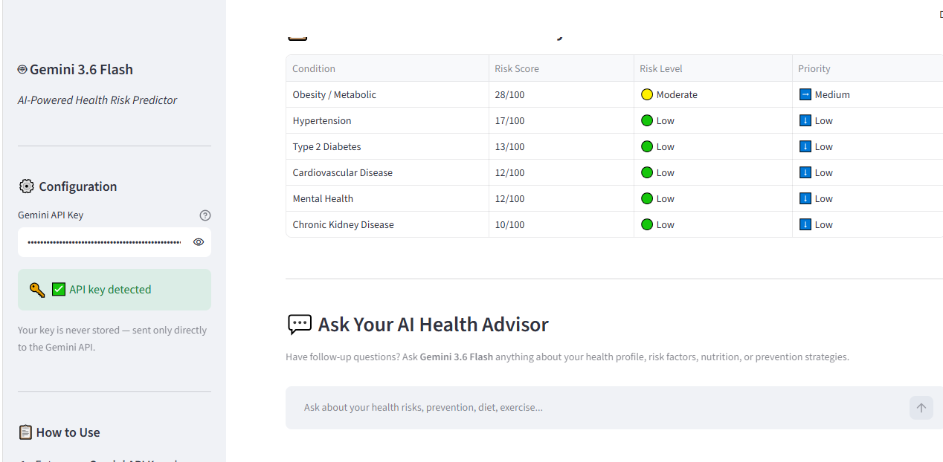
Result (1/2)
Upload screen and AI-generated patient-friendly summary, powered by Google Gemini 2.5 Flash.

Slide 9
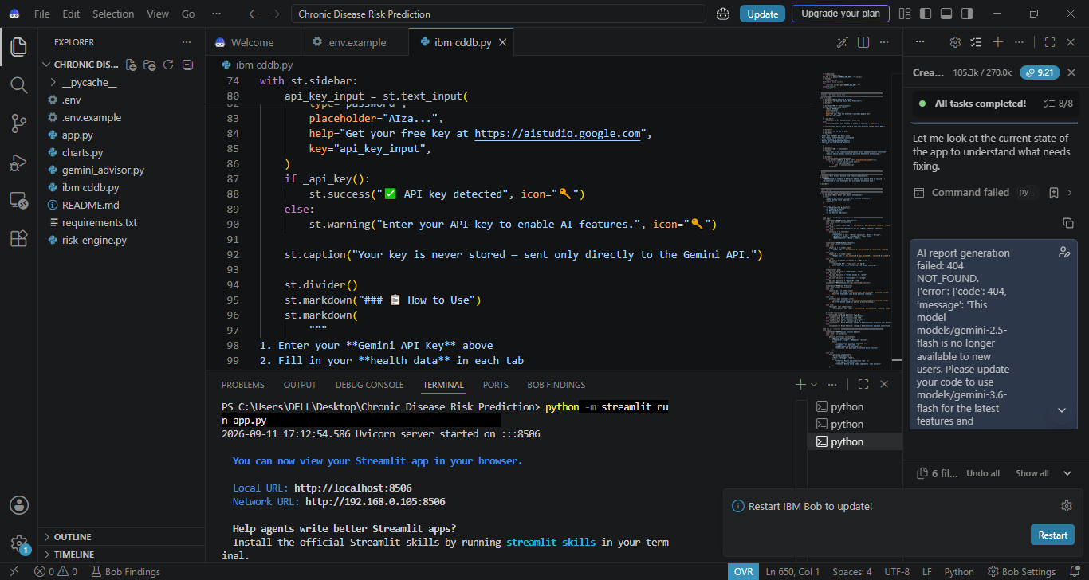
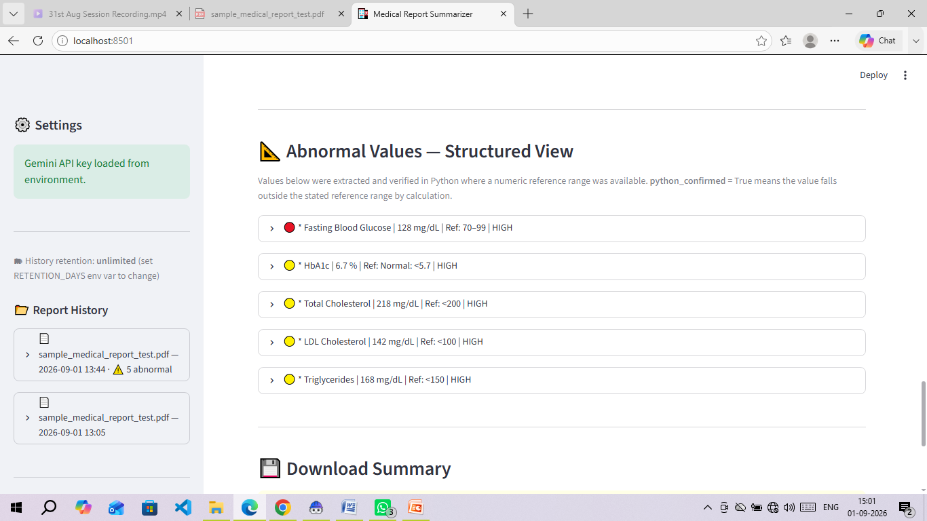
Result (2/2)
Structured abnormal-value view (Python-verified against reference ranges) and doctor questions / next steps generated for the patient.

Slide 10
Conclusion
The application successfully converts complex lab reports and discharge summaries into clear, patient-friendly summaries with key findings, explained terms, and next steps.
Abnormal values are reliably flagged by combining Gemini’s language understanding with a Python-based numeric check against reference ranges.
OCR fallback allows the tool to also handle scanned or photographed reports, not just digital PDFs.
A clear medical disclaimer is shown on every summary, keeping the tool safely positioned as informational, not diagnostic.
Challenges included accurately extracting tables from varied report layouts, tuning OCR for scanned images, and a PDF-export formatting issue for the downloadable summary.

Slide 11
Add multi-language support (Hindi and other regional languages) so more patients can understand their reports.
Fix and improve the downloadable PDF summary export.
Track multiple reports over time to show trends in a patient’s health metrics.
Build a mobile app version and add a doctor-facing view for verified professionals.
Explore integration with hospital and clinic record systems for direct report import.
Personalized Preventive Recommendations
Provide recommendations based on individual risk factors, lifestyle, and health parameters.
Integration with Wearable Devices
Connect smartwatches and health-monitoring devices to collect real-time health data
Future scope

Slide 12
References
Sources and documentation used while building this project:
Google Gemini API documentation
Python Documentation
Streamlit Documentation
Google Gemini / Google GenAI Documentation
IBM Bob
Research papers related to chronic disease prediction and machine learning
Dataset source used for your project

Slide 13
Deployment link / github link
Github Link:
Deployment Platform: Streamlit Community Cloud
Live App: a

Slide 14
THANK YOU

